Slide 1

RECURSIVE FUNCTION
University of Essex online
Launching into Computer Science
Seminar 5
Alice Villar
Professor Dr. Nawaz Khan

Slide 2
PYTHON RECURSIVE FUNCTION
Recursion is a method of solving a problem where the solution depends on solutions to smaller instances of the same problem (Graham, 1990).
Why use recursion in programming?
We use recursion to break a big problem in small problems and those small problems into further smaller problems and so on. At the end, the solutions of all the smaller subproblems will help in finding the solution of the big main problem.
Recursive functions
Programming languages support recursion by allowing functions to call themselves within their code.
A function is said to be recursive if it calls itself.

Slide 3
PYTHON RECURSIVE FUNCTION
Advantages of recursive functions
Allows programmers to use repetitive structures present in many problems.
A complex task can be broken down into simpler sub-problems.
Makes the code look clean and more “elegant”.
Disadvantages of recursive functions
Sometimes the logic behind recursion is hard to follow.
Recursive functions are hard to debug.
Recursive functions call uses more memory and time.

Slide 4

PYTHON RECURSIVE FUNCTION
Recursion for Fibonacci
The Fibonacci sequence is the sequence of numbers where the first two numbers
are 0 and 1. Each subsequent number is the sum of the previous two numbers
in the sequence.
The Fibonacci sequence looks like this:
…and so on
…and so on

Slide 5
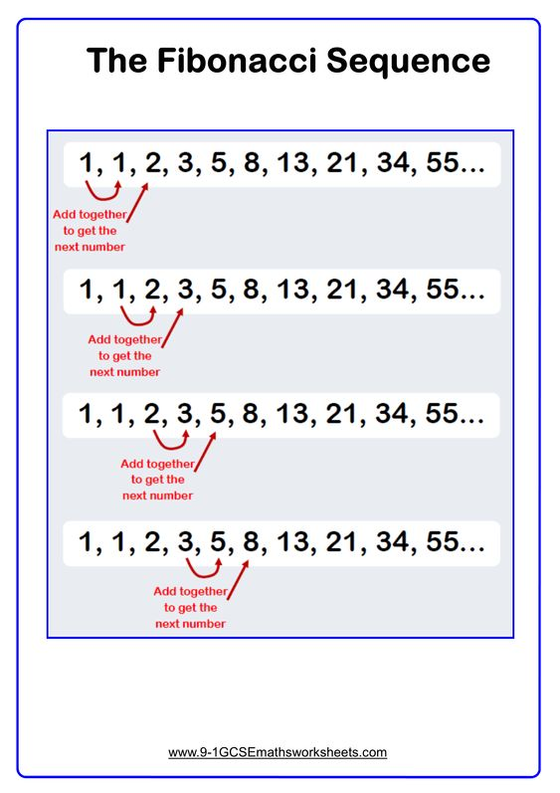
PYTHON RECURSIVE FUNCTION
Each number is the sum of the previous two numbers

Slide 6
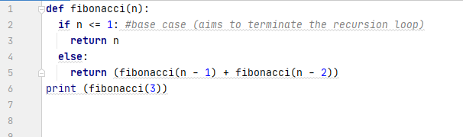


PYTHON RECURSIVE FUNCTION
General Rule:
Fibonacci (num) = num if num<=1
Fibonacci (num) = Fibonacci (num-1) + Fibonacci (num-2) If a num > 1
Python Program to print Fibonacci sequence:
BASE
CASE
OUTPUT: 2
…and so on
…and so on

Slide 7
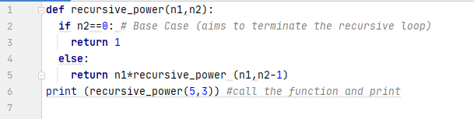
PYTHON RECURSIVE FUNCTION
Challenge
Problem Write a recursive function called recursive_power that takes two integers as
parameters.
The first parameter is the base and the second parameter is the exponent.
Return the base parameter to the power of the exponent.
Expected Output
If the function call is recursive_power (5, 3), then the function would return 125
recursive_power (base, exponent)
recursive_power (n1,n2-1)
recursive_power (5,3-1)
recursive_power (5,2-1)
recursive_power (5,1-1)

Slide 8
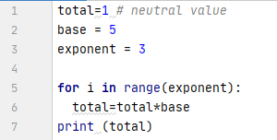
PYTHON RECURSIVE FUNCTION
Solving the same problem without recursion

Slide 9
PYTHON RECURSIVE FUNCTION
References:
Rao, Anirudh. Python Functions Tutorial: Working With Functions in Python, Part 3. BigData Zone. Available from: https://dzone.com/articles/python-functions-tutorial-working-with-functions-i-1
Curso de Python - Funções - Recursividade - Boson Treinamentos: https://www.youtube.com/watch?v=fbj5Y19x0fs
Math Work Sheets:
https://www.mathworksheets.com/
Graham, R.L., Knuth, D. E., and Patashnik, O. Concrete Mathematics.
Addison-Wesley Pub. Co., Reading, MA 1990.

